Slide 1
The 4th Family Medicine Review Course

Slide 2
Inhalers
Nasal spray
Insulin injection
Dr Fareedah Alkandery
R3 Family Medicine Resident

Slide 3
Inhalers
Before Starting :
Introduce yourself to the patient
Confirm the name and date of birth
Check his understanding of asthma and of the inhaler
Explain the medication
Check always the correct drug to the patient and the expire date
Ask him if he has any concern

Slide 4
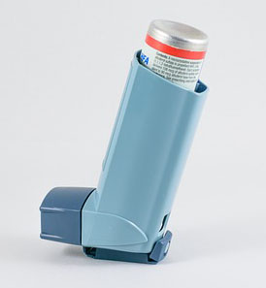
How to use MDI
Remove the cap from the mouthpiece
Shake the inhaler for 5 seconds
Hold the inhaler between index finger and the thumb
Sit up straight or Stand up
Tilt your head back slightly
Exhale away from inhaler
Put the inhaler in your mouth , press the inhaler and start breathing in at the same time, take a slow and deep breath
Hold your breath for 10 seconds , exhale slowly through your mouth or nose
Wash his mouth completely
Repeat steps 2 to 8 after 30 seconds if another dose is required
https://www.youtube.com/watch?v=fHYTz-ZoRLw

Slide 5
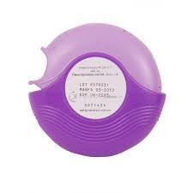
How to use Diskus (Seretide)
Check Dose counter
Open using thumb grip
Holding Horizontally, load dose by sliding lever until it clicks
Breath out gently away from mouthpiece
Place mouth piece in mouth
Breath in steadily and deeply
Hold breath for 10 seconds
Breath out gently away from mouthpiece
Close cover to click shut
Wash your mouth with water to minimize the risk of oral thrush
https://www.youtube.com/watch?v=75j3fKp_cnE

Slide 6
How to use symbicort
Remove the cover
Check dose counter
Keep inhaler upright while twisting grip around and then back until click is heard
Breath out gently away from mouthpiece
Place mouthpiece between teeth and close lips to form a goad seal
Breath in strongly and deeply, Hold your breath for 10 seconds
Breath out gently away from mouthpiece
Wash the mouth
https://www.youtube.com/watch?v=GbTnjyQyybo

Slide 7
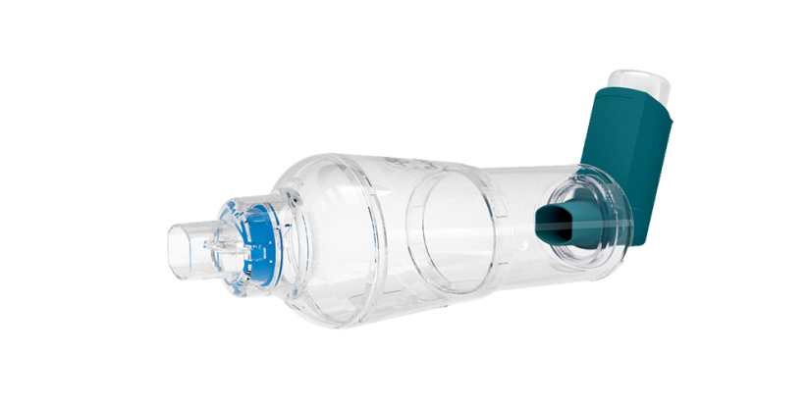
MDI wit Spacer
Shake the inhaler
Remove the cap from mouthpiece
Fit the inhaler into spacer
Sit up straight and breath out completely
Place the spacer in the mouth
Press the inhaler
Breath in steadily and deeply
Hold breath for 10 seconds and then breath out slowly
Wash the spacer every month with soap and warm water
https://www.youtube.com/watch?v=0bU6fCN44FA&t=76s
https://www.youtube.com/watch?v=_Asee8TyHOw&t=3s

Slide 8
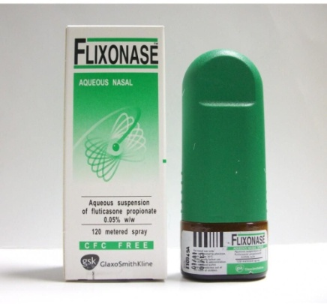
How to use nasal spray
Blow your nose gently before using spray
Wash your hand with soap and water
Shake the bottle for 10 seconds
Remove the cap from nasal spray
Head upright and tilted forward slightly and press your finger one side to close one nostril
Gently insert the nasal spray into the other nostril
Breathe in as you spray (but do not sniff hard as the spray then travels past the nose to the throat).
Do not angle the canister towards the middle or side of the nose, but straight up. With your head tilted forward, the spray should go to the back of your nose.
Repeat in the other nostril.
https://www.youtube.com/watch?v=r4rWN8T89yU

Slide 9
Explain how you can use the inhalers
Explain the use of Spacer? How you can wash it? When to use the spacer?
Nasal spray ( direction and to close one nostil)

Slide 10
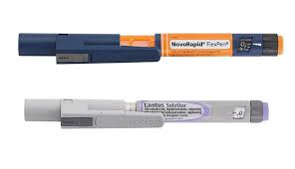
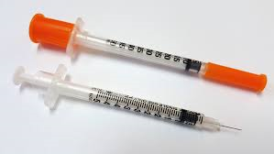
Insulin Injection
Pen injection
Needle injection

Slide 11
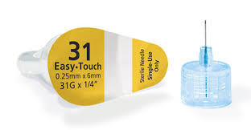
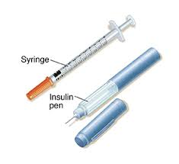
Needle injection
Things you will need:
Alcohol wiped
Insulin bottle
Syringe
Container

Slide 12
Steps of injecting insulin by needle
1- welcome the patient and ask for patient’s name ,ID, and prescription.
2- check drug name ,dose prescribed to the patient.
3- check date of expiration and the clarity of insulin ( if any clot seen don’t use ).
4-Prepare the equipment needed for the injection (cotton ,alcohol wipes, new syringe and safe place to discard the syringe that is out of reach of children .
5-wash your hands with water and soap.
6- roll the insulin between your hands for few seconds (throw the insulin if you notice the liquid is not clear , discolored or thickened, don’t shake the bottle may cause bubbles
7- Remove the cap from insulin bottle , clean the top of the insulin vile before inserting the needle.
8-aspirate air equivalent to the desired dose of insulin by the syringe.

Slide 13
9-inject the air inside the insulin bottle then rotate the bottle upside down then aspirate the desired dose of insulin prescribed .
10- take the syringe out and check any air or bubbles ?adjust.
11-clean the site you chose to inject the insulin by wipes in circular way.
12- pinch the skin by the other hand .(pinching process may not be needed).
13- hold the injection like a pen and inject the insulin in 90 degree angle.
14- take out the injection( don’t rub the injection site ) and if there is any bleeding apply light pressure to the site with gauze.
15 –keep the insulin in refrigerator not freezer.
16- once done throw out the injection in safe container and never share or re use.
https://www.youtube.com/watch?v=bBZXkNbpOGQ

Slide 14
Pen Insulin
https://www.youtube.com/watch?v=Pl28IILPD
TU

Slide 15
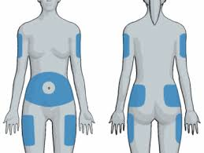
Site to inject insulin ?
Outer arm
abdomen
Upper outer of the thigh
Hip area (buttocks)
1- Always change the site which you chose to inject(rotate their injections sites. ( 2 cm ) 2 finger between others .why?
2-if you notice redness ,ulcer or scar don’t inject in this part ..

